Slide 1

Liquid Level detection
BUS ADM 745 – Group 1 Project 2
Aaron Cochran
Ian Brown
Varun Vijaywargi
Vamsidhar Reddy Bhavanam
Using computer vision AI

Slide 2

Liquid Level detection
Using computer vision AI

Slide 3
Liquid Level detection
We are looking at two different computer vision models one is a binary case while the other is a tertiary case
Using computer vision AI

Slide 4
Data preparation
The data set was reduced to remove columns that were not needed.
Using computer vision AI

Slide 5
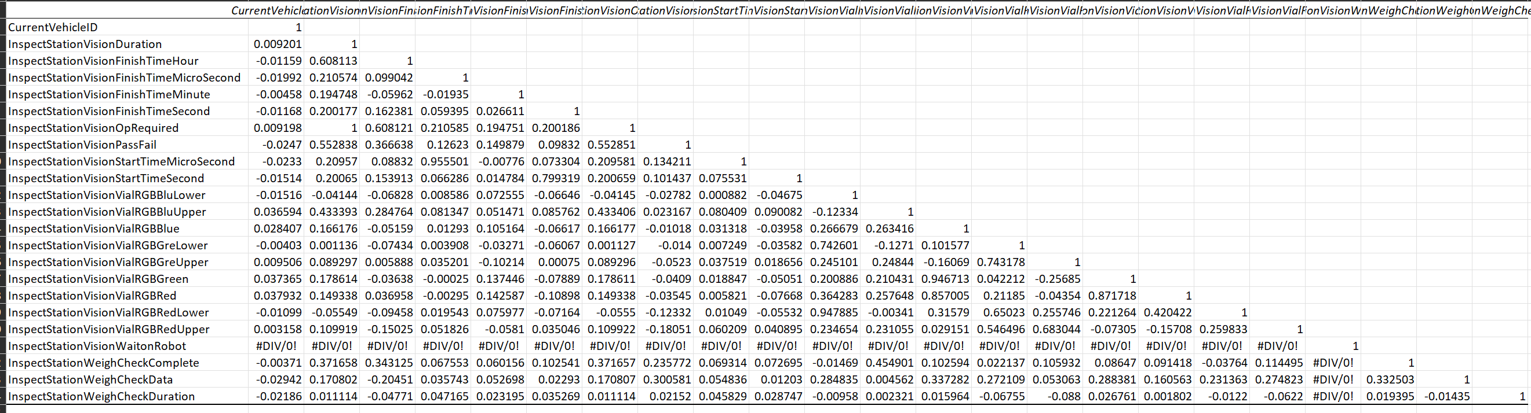
Patterns in the data
A partial data inspection using correlation analysis was performed to determine if there are interaction variables to pursue.
Using computer vision AI

Slide 6
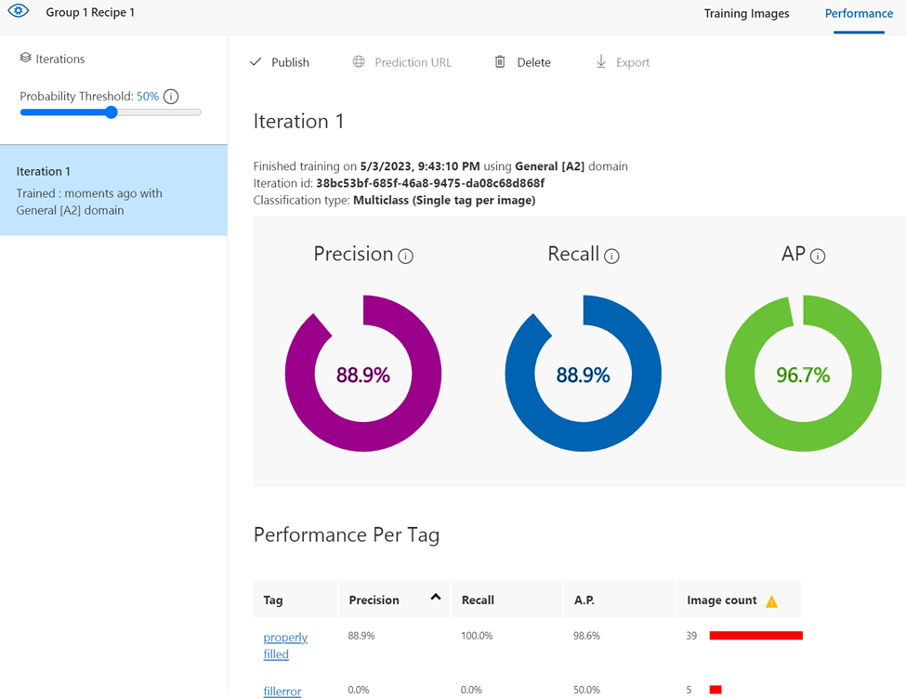
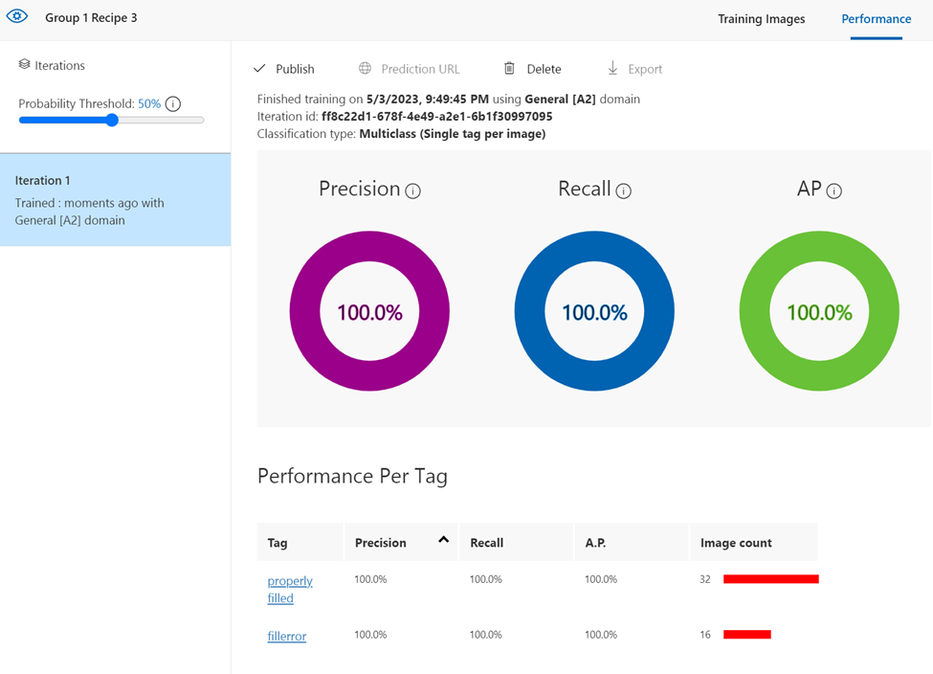
Binary computer vision model
Binary computer vision model performance
Recipe 1
Properly filled 39
Fillerror 5
Recipe 3
Properly filled 32
Fillerror 16
Using computer vision AI

Slide 7

Liquid Level detection
Tertiary computer vision model performance
Using computer vision AI

Slide 8
Recipe 1 (75 images)
Data linked classification
11 did not have serial weight
56 Over filled
6 Properly filled
2 Under filled
Recipe 3 (60 images)
Data linked calssification
6 did not have serial or weight
48 Over filled
5 Properly filled
1 Under filled
Manual Classification
17 Bad were missing vial or blank image
6 Over filled
36 Properly filled
5 Under filled
Manual Classification
18 Bad were missing vial or blank image
1 Over filled
28 Properly filled
7 Under filled
Notes:
Recipe 1
Recipe 1 75 images
17 bad images that had no vial or were not even a picture
4 Over filled
36 properly filled
5 underfilled
Recipe 3 60 images
18 were bad
1 overfilled
28 properly filled
7 under filled

Slide 10


Slide 11
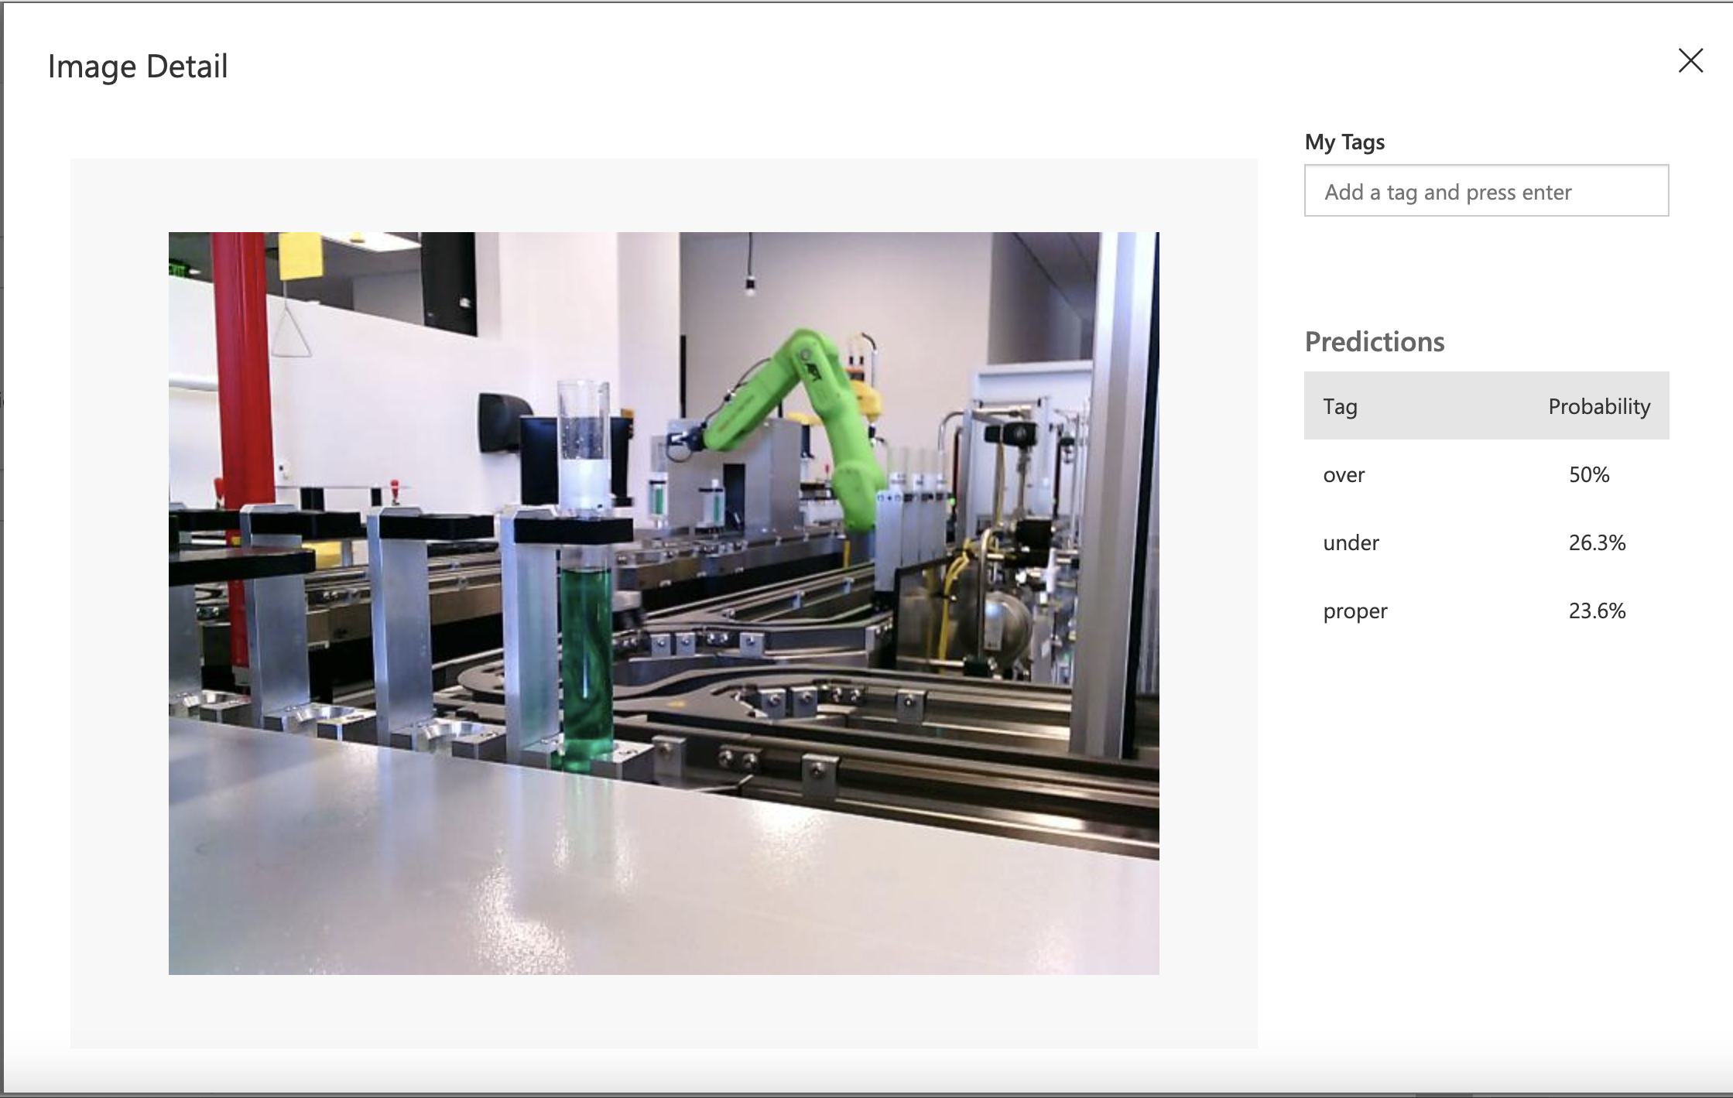

Slide 12



